Slide 1
SMART Water SYSTEM
-Based on IoT

Slide 2
INTRODUCTION
Title : Smart water System
Objective : The objective of implementing a Smart Water System is to optimize water resource management, enhance water quality, reduce wastage, and ensure sustainable access to clean and safe water for both urban and rural communities. This is achieved through the integration of advanced technologies, data analytics, and real-time monitoring, with the primary goals of conserving water, improving operational efficiency, and mitigating water-related challenges such as scarcity and pollution
Agenda :
IoT Sensor Design
Real-Time Transit Information Platform
Integration Approach

Slide 3
Smart water system :Components
A "Smart Water System" project typically involves the use of various components like NodeMCU, relay modules, a breadboard, soil moisture sensors, and infrared (IR) sensors to create an intelligent and automated system for managing water resources and monitoring related environmental conditions. Here's an explanation of how these components can be used together:

Slide 4
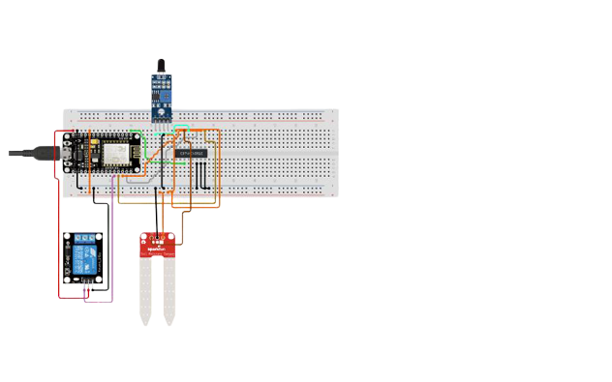
IoT Sensor Design
Components:
Node MCU
Relay modules
Breadboard
Soil moisture sensors
Infrared (IR) sensors

Slide 5
NodeMCU (Microcontroller Unit):
NodeMCU is a low-cost open-source IoT platform based on the ESP8266 Wi-Fi module.
It serves as the central controller for the Smart Water System.
NodeMCU connects to your Wi-Fi network, allowing it to transmit and receive data over the internet.
It can run code to control and coordinate the other components in the system.
Relay Module:
The relay module is used to control water pumps, valves, or other water-related equipment.
NodeMCU can control the relay module to turn water sources on or off based on sensor readings or user commands.

Slide 6
Breadboard:
The breadboard is a platform for prototyping and connecting various electronic components.
It allows you to create a clean and organized circuit without soldering.
Soil Moisture Sensor:
Soil moisture sensors are used to measure the moisture content in the soil.
They help in determining when and how much to water plants or crops.
NodeMCU can read data from the soil moisture sensor to make informed decisions about irrigation.
Infrared (IR) Sensor:
IR sensors can be used to detect the presence of objects or obstacles in the system.
In a water system, they can be employed to prevent collisions or blockages in water channels or pipes.
When an object is detected, NodeMCU can trigger actions like stopping the water flow or sending alerts.

Slide 7
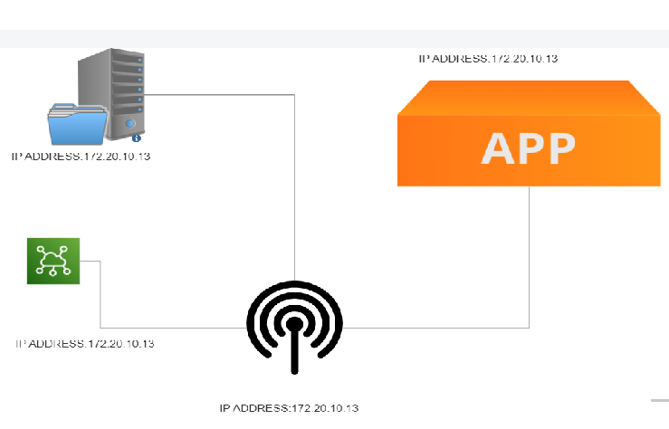
Real-Time Transit Information Platform

Slide 8
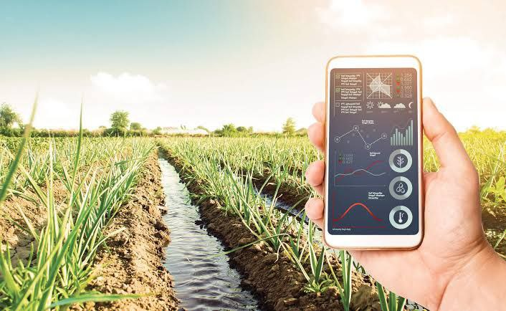
Integration Approach
Mobile app interface that displays real-time parking availability to users

